Slide 1

Capstone project
UNIVERSITY SUCCESS ANALYSIS
- RAKESH BABU ARETI

Slide 2
MAIN PROBLEM STATEMENT
Compare university rankings across different systems, assess the impact of ranking criteria on university positions, and analyse changes in university metrics over time. Utilize SQL and Excel for data aggregation and for EDA. Create a Power BI dashboard to provide a comprehensive view of university rankings.

Slide 3
OBJECTIVE
The main Objective of conducting a university success analysis is to gain a thorough understanding of universities, including their ranking systems, the specific criteria used for rankings, and various related metrics. This analysis involves comparing university rankings across different systems, evaluating how ranking criteria influence university positions, and examining changes in university metrics over time.
ANALYSIS AND SCOPE
The analysis encompasses a broad spectrum, delving into diverse dimensions of multiple institutions. It extends to a global scale, examining rankings, and thoroughly analysing universities. Additionally, the scope includes an in-depth student analysis. This comprehensive approach aims to provide a holistic understanding of the intricate dynamics within and across institutions on a global level.
GOAL
The Primary goal is to provide comprehensive insights into the dynamics of higher education institutions, enabling a nuanced understanding of their performance, criteria for assessment, and trends over the years.

Slide 4
INSIGHTS AND RECOMMENDATIONS
The comprehensive analysis within the Power BI dashboard will yield valuable insights into the academic strengths of universities, highlighting enrolment trends over time. It will assess the performance of various institutions. Furthermore, the analysis will recommend strategic initiatives to enhance academic excellence and foster student engagement, contributing to the overall success and competitiveness of universities in the higher education landscape.
REPORT AND PRESENTATION
The final deliverable will consist of a detailed presentation describing the data sources, data modelling methodologies, and data cleansing processes used in creating the Power BI dashboard.
DASHBOARD
The Final Dashboard will consist of the things as per the requirement and it will help us to understand the detailed information of every aspect of the Universities considering all the factors.

Slide 5
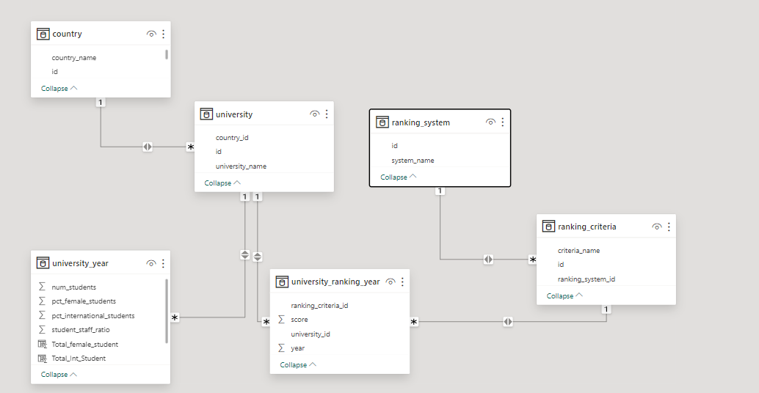
ER DIAGRAM

Slide 6
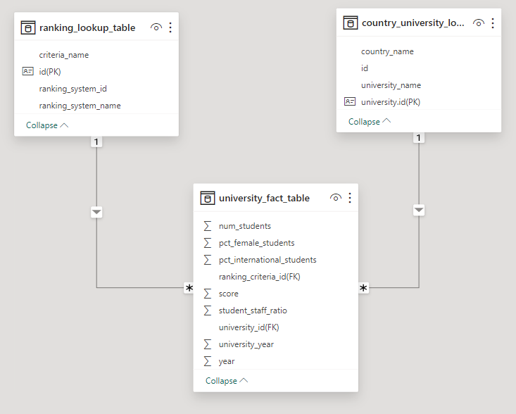
ER DIAGRAM (Changed as per the Requirement)

Slide 7
POWERBI PROBLEM STATEMENTS

Slide 8
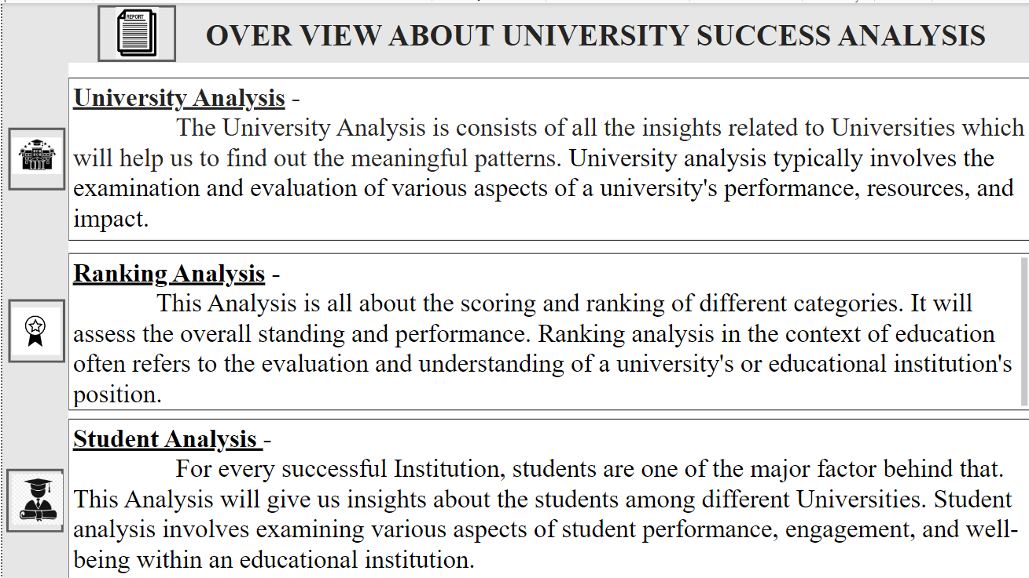
The University Success Analysis includes University Analysis, Ranking Analysis, Student Analysis.

Slide 9
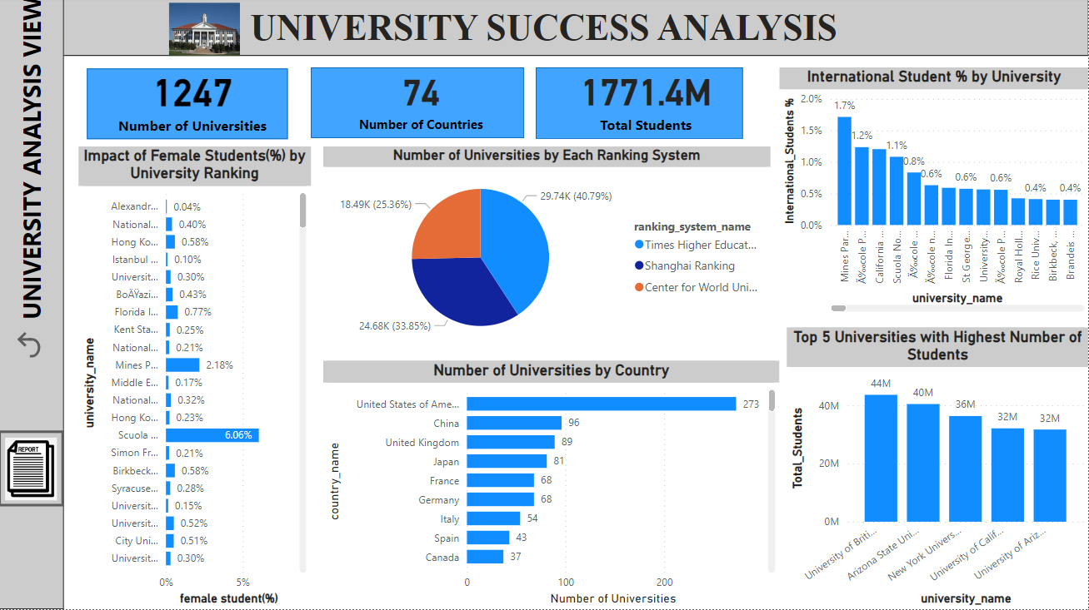
UNIVERSITY ANALYSIS VIEW

Slide 10
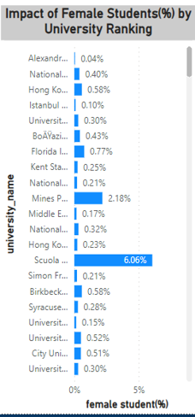
Problem Statement-
How does the percentage of female students impact a university's ranking? (Q-8)
Explanation-
The University Ranking has been considered as the average score of each university. Here the female % has a good impact on University’s ranking. Sorted the average score in Descending Order, we can clearly understand that Female Percentage has Moderate Impact on University’s Ranking.

Slide 11
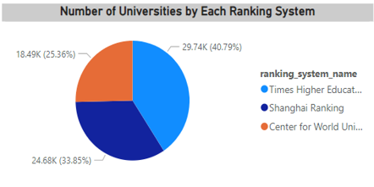
Problem Statement-
How many universities are ranked by each ranking system? (Q-3b)
Explanation-
The above pie chart shows the distribution of Universities with respect to the Ranking System’s. The highest portion is been occupied by “Times Higher Education World University Ranking” with 40.79% (29.74K) and then its followed by “Shanghai Ranking” with 33.58 % (24.68K), “Centre for World University Ranking” with 25.63 % (18.49K)

Slide 12
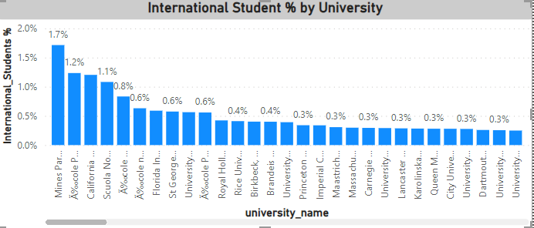
Problem Statement-
How does the percentage of international students vary across different universities? (Q-10)
Explanation-
International Student Percentage has been created and then it is used for the problem statement. As per the Visual, the Mines ParisTech has been the highest percentage as compared with other Universities. Each University has different Number of Universities. The difference can be vary and that can be seen in the Visual.

Slide 13
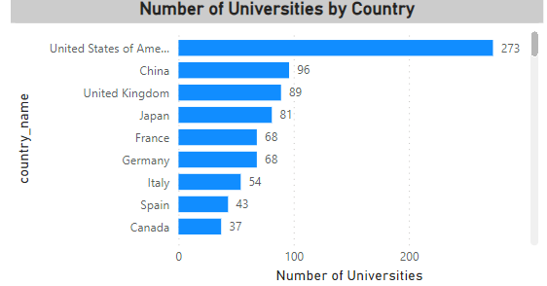
Problem Statement-
How many universities are there in each country? (Q-1)
Explanation-
Universities by each Country can be seen the Visual, the United States of America (USA) has the highest number of Universities, followed by China with 96, United Kingdom (UK) with 89 and the list continues

Slide 14
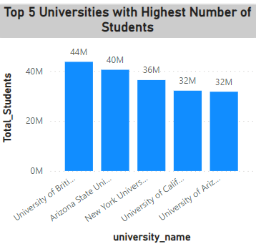
Problem Statement-
Which university has the highest number of students? (Q-9)
Explanation-
Actually, the Questions is to find top1 University with Highest number of Students In it. I tend to fins top 5 to make it visible concisely. The University with Highest number of students is University of British Columbia.

Slide 15
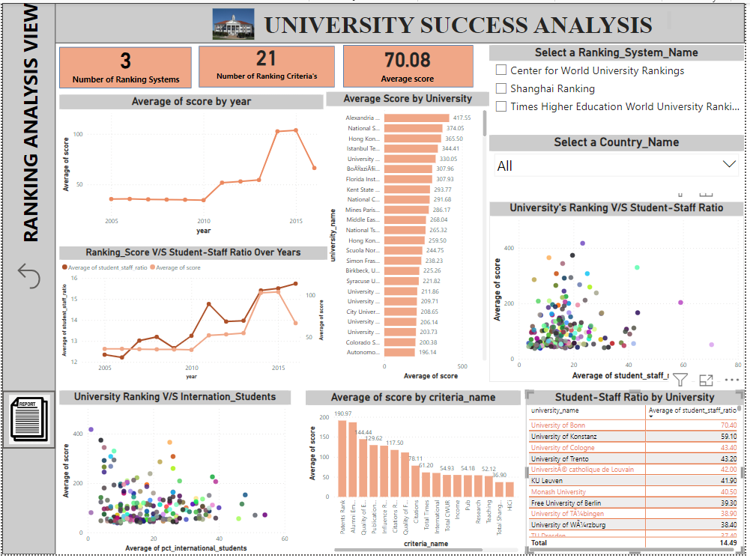
RANKING ANALYSIS VIEW

Slide 16
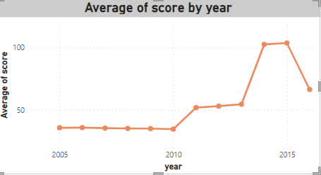
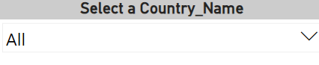
Problem Statement-
Are there any significant trends or patterns in the rankings of universities from different countries? (Q-18)
Explanation-
I didn’t find any Proper pattern over years for average score. To know about it more we can use a slicer for country to undersrand the patterns or trends in each country. It might be more insightful rather than like this.
Country Name Slicer

Slide 17
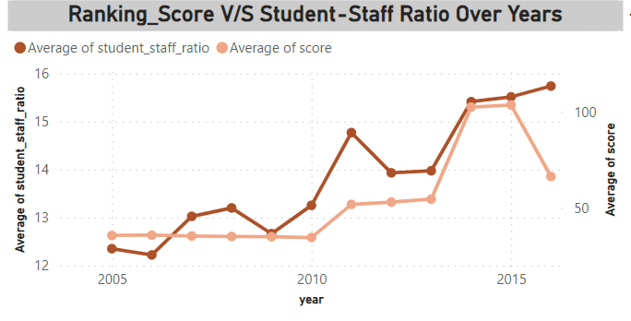
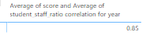
Problem Statement-
Is there a correlation between a university's ranking score and the student-staff ratio over the years? (Q-13)
Explanation-
There is a Positive Correlation between Ranking Score (Average of Score) and Average of Student-Staff-Ratio over the years, which means going with Year by Year, the Student-staff ratio increases then average-score increases and vice – versa.
Correlation Coefficient

Slide 18
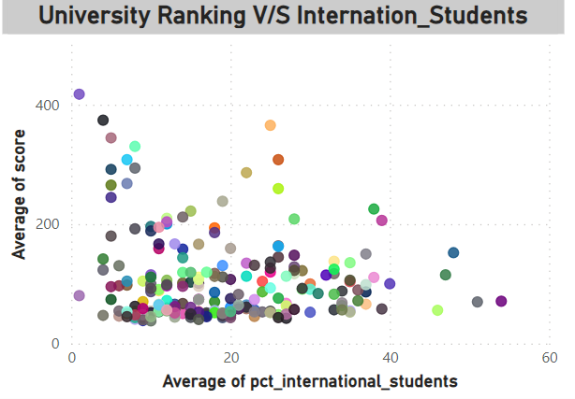
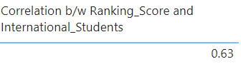
Problem Statement-
What is the impact of university's ranking on the number of international students it attracts? (Q-15)
Explanation-
There is Positive impact on University’s Ranking on the Number of International Students it Attracts. As the university’s Ranking has increase the number of international students for that University will get increased and vice- versa. This shows a Positive impact (relation).
Correlation Coefficient

Slide 19
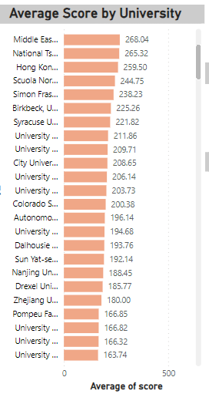
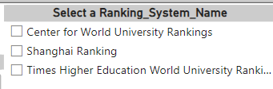
Problem Statement-
What is the average score for universities according to each ranking system? (Q-15)
Explanation-
The average Score for each University is shown in the Visualisation. To know about the each ranking system average score for a University we may use slicer in the Power BI for ranking system name and it can be analysed as per the Requirement.
Ranking System Name Slicer

Slide 20
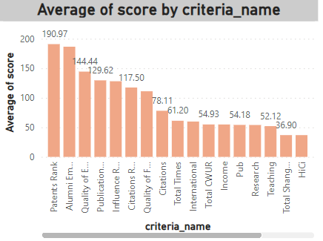
Problem Statement-
What are the most important criteria considered by ranking systems? (Q-6)
Explanation-
As it comes to ranking, we considered the average of score for each criteria name. to know about the most important criteria by ranking system, we can use slicer of it. But, when it comes to the overall then the most important criteria is ‘Patents Rank’.
Ranking System Name Slicer

Slide 21
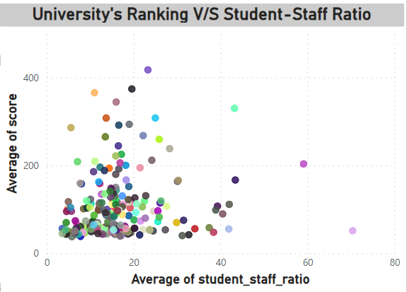
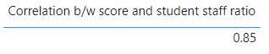
Problem Statement-
Is there a correlation between a university's ranking and its student-staff ratio? (Q-15)
Explanation-
there is Positive Correlation between University’s ranking(average of score) and the student-staff ratio. It means if the university’s ranking increases then the student-staff ratio also gets increased and vice – versa.
Correlation Coefficient

Slide 22
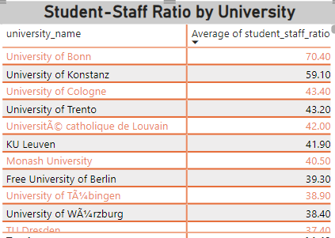
Problem Statement-
How does the ranking system affect a university's student-staff ratio? (Q-5)
Explanation-
The Matrix represents the average student-staff ratio for each University. To know about the affect of each ranking system, we could use slicer for it and make meaningful insights from the Matrix. It could be done in PowerBi only.
Ranking System Name Slicer

Slide 23
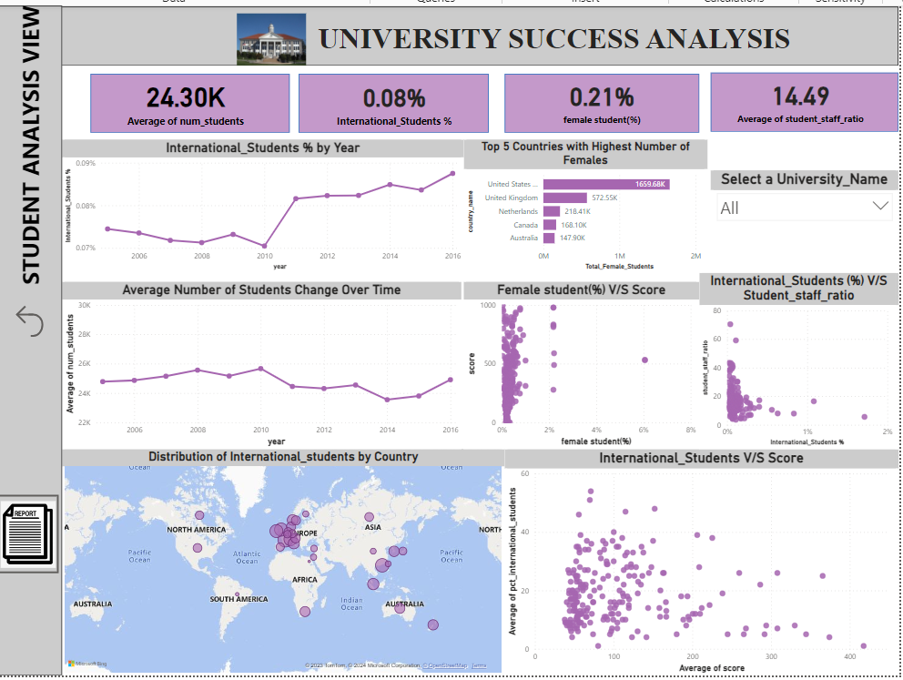
STUDENT ANALYSIS VIEW

Slide 24
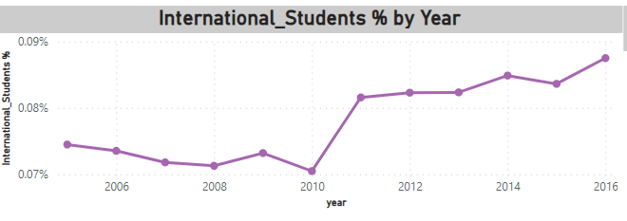
Problem Statement-
How does the percentage of international students vary across different years? (Q-14)
Explanation-
The Percentage of International Students over years can be been the line chart. At the beginning stage, it has slight difference in year to year and there is significant rise of International Student percentage from 2011 and the rest of the year continues to be change with slight difference from year to year.

Slide 25
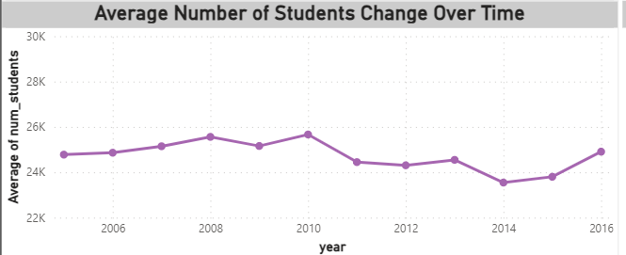
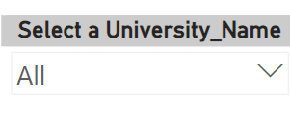
Problem Statement-
How does the number of students in universities change over time? (Q-12)
Explanation-
The above visual shows the change over time for the average number of students. It more similar to following like wave structure. To know about each University’s change in Number of Students, we can use the university name slicer. It can provide the change over time for each University.
University Name Slicer

Slide 26
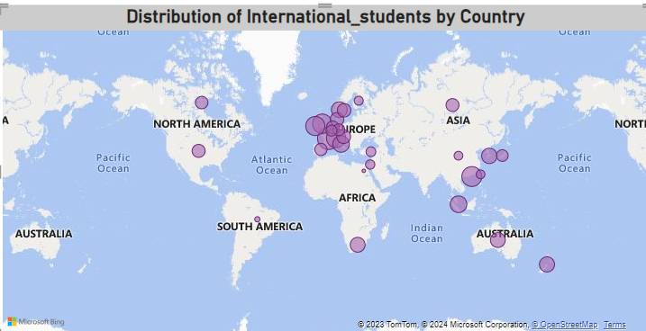
Problem Statement-
What is the distribution of international students across different countries? (Q-2)
Explanation-
The Distribution(Percentage) of International Students across Different Countries can be seen the Map Visualisation with bubble size. We can know that the distribution can be seen in the Power Bi clearly by placing the cursor over there.

Slide 27
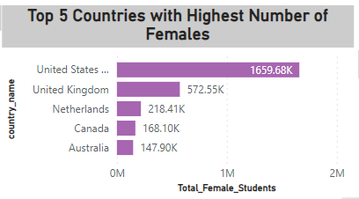
Problem Statement-
Which country has the highest number of female students enrolled in universities? (Q-3)
Explanation-
The actual question is to find Country with Highest number of female Students. To make the visualisation impressive, I used top 5 Countries with highest female students. SO, at last the United States of America (USA) has the highest number of Female Students as compared to other Countries.

Slide 28
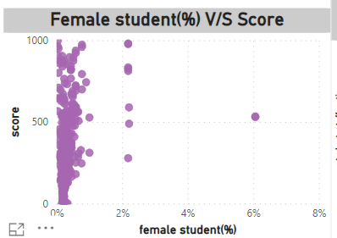
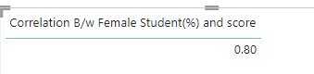
Problem Statement-
Is there a relationship between a university's ranking score and the percentage of female students enrolled?
(Q-16)
Explanation-
There is a Positive relation between the University’s Score and Female Student Percentage. It means if the Score Increases, then there might be chance to increase the female percentage as well and vice – versa.
Correlation Coefficient

Slide 29
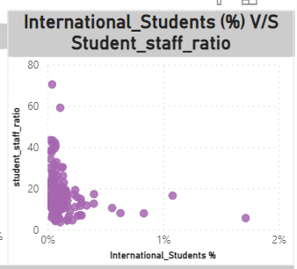
Problem Statement-
Is there a relationship between a university's ranking score and the percentage of female students enrolled?
(Q-17)
Explanation-
There is a Positive relation between International Student (%) and Student-Staff Ratio. It means if the Student-staff ratio Increases, then there might be chance to increase the International Student percentage as well and vice – versa.
Correlation Coefficient

Slide 30
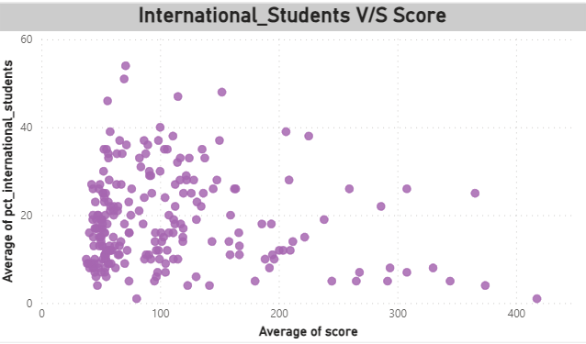
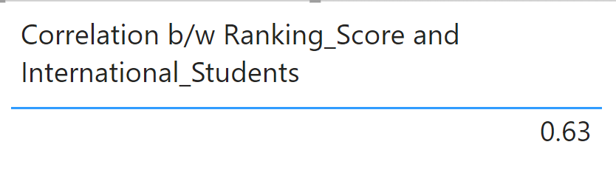
Problem Statement-
Is there a correlation between a university's score and the number of international students? (Q-7)
Explanation-
There is a Positive relation between International Students and University’s Score. It means if the university’s Score Increases, then there might be chance to increase the International Students as well and vice – versa.
Correlation Coefficient

Slide 31
EDA
PROBLEM STATEMENTS

Slide 32
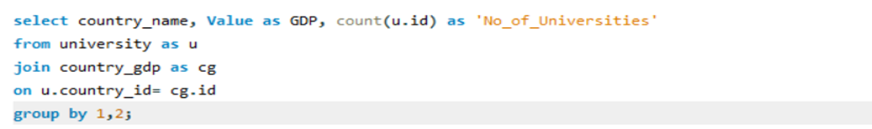
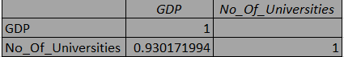
Problem Statement-
SQL Query-
Is there a correlation between a country's GDP and the number of universities? (Q-1)
Visual Representation-
Explanation-
The correlation between Country's GDP and No_of_Univerisites is 0.94(0.930171994)there is a positive correlation between Country's GDP and No_Of_Universities. If the country's GDP increases then the No_of_Universities will also increases.
Correlation Coefficient in Excel-

Slide 33
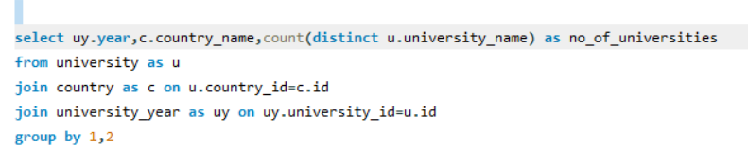
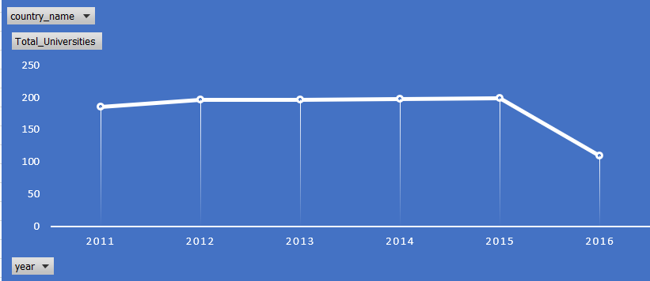
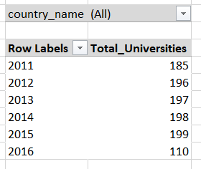
Problem Statement-
SQL Query-
How has the number of universities changed over the years in each country? (Q-2)
Explanation-
Visual Representation-
Here the No_of_Universities has a change over year for each country. If we wanted to know to how the change has been for each country we can use the filter option and select the countries we wanted to look and analyse them.
Pivot table in Excel-

Slide 34
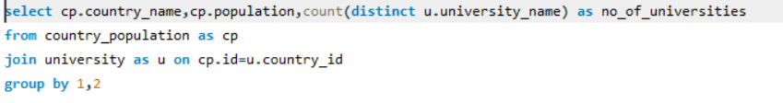
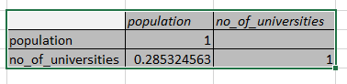
Problem Statement-
SQL Query-
Is there a relationship between a country's population and the number of universities? (Q-3)
Explanation-
Visual Representation-
The correlation between Country's population and no_of_universities is 0.28 (0.285324563) The Relation Between Country's Population and No_of_Universites is Positive relation. It shows that if the Population of Country Increases then automatically Count of Universities will get increased.
Note-however there are some Scatter points long that might be those Country’s Population is far from the other country's population.
Correlation Coefficient in Excel-

Slide 35
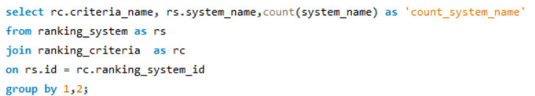
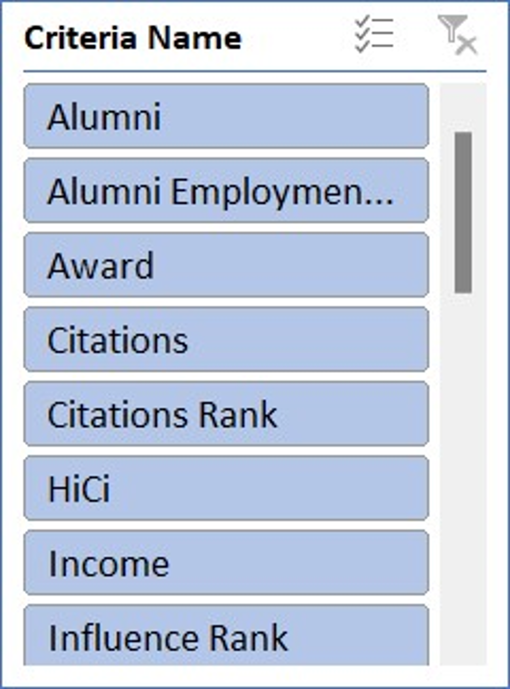
Problem Statement-
SQL Query-
Are there any common criteria used by different ranking systems? (Q-4)
Visual Representation-
Explanation-
There is no Common Criteria that followed by the ranking system. There might be each ranking system has its own consideration factors.
Slicer

Slide 36
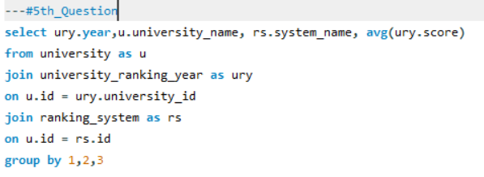
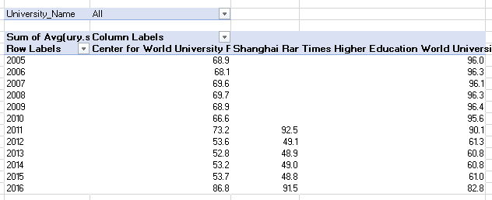
Problem Statement-
SQL Query-
What is the trend in university rankings over the years according to each system? (Q-5)
Visual Representation-
Explanation-
The trend of University in ranking in each system can be seen that there are 3 different university ranking system and one ranking has started from the year 2011. But the overall ranking in universities has begun with a good average and then slowly declined it in the year 2012. then stayed constant from 2012 to 2015 and then started rising. for all the 3 Systems the same trend has emerged irrespective the shangana Ranking has begun in the year 2011.
Pivot Table in Excel-

Slide 37
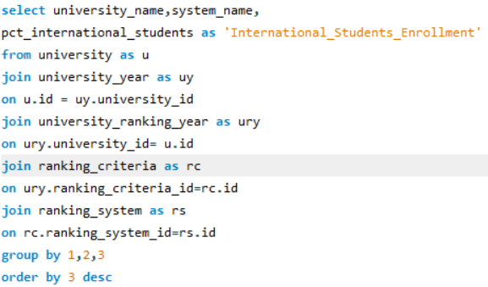
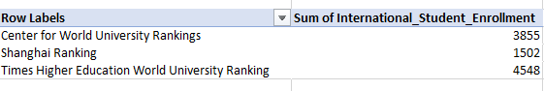
Problem Statement-
SQL Query-
How does the choice of ranking system affect a university's international student enrolment?(Q-6)
Visual Representation-
Explanation-
The choice of ranking system affects University 's International Students Enrolment. Here, The Times Higher Education World Ranking University Rankings has impacted the students enrolment into different Universities which consists of this particular ranking system Universities and also the other ranking system were impacted the in international students as well. From this, we can know that ranking system will impact the enrolment of international students.
Pivot Table in Excel-

Slide 38
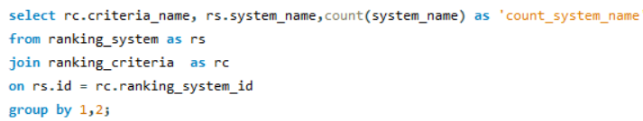
Problem Statement-
SQL Query-
Are there any criteria that have different weights in different ranking systems? (Q-7)
Visual Representation-
Explanation-
Here every ranking system has common count of criteria's which means they use distinct criteria.
Slicer

Slide 39
Problem Statement-
How have the weights of ranking criteria changed over time?(Q-8)
Visual Representation-
Explanation-
The weights of the ranking criteria over time has begun and stayed constant for a time span and then it made a significant rise from the year 2011 up o 2015 and a decline has faced in the year 2016

Slide 40
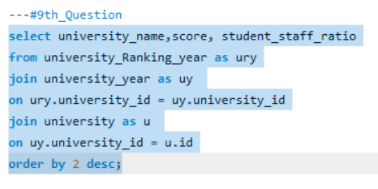
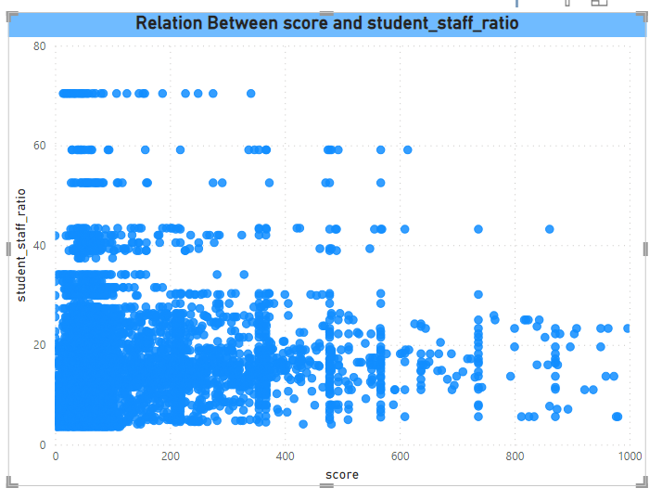
Problem Statement-
SQL Query-
Is there a relationship between a university's score and the student-staff ratio? (Q-9)
Visual Representation-
Explanation-
There is a Positive Correlation Between Score and the Student_Staff_ratio, which means if the student_staff_ratio increases then score will rise as well and vice-versa.

Slide 41
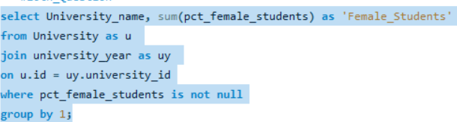

Problem Statement-
SQL Query-
How does the number of female students differ among universities? (Q-10)
Pivot table in Excel-
Explanation-
As per my Understanding, the Number of female students differ among universities can be seen the table, as the number of universities are more than 200 we can not make them to fit in any of the visualisation.
<----Large List

Slide 42


Problem Statement-
SQL Query-
What is the distribution of universities across different countries?(Q-11)
Visual Representation-
Explanation-
The above map show the Number of Universities across different Countries. The darker shade of the colour Shows that highest number of Universities in that Particular Country, then as the colour shade Decreases the number of Universities in that Country are low.

Slide 43

Problem Statement-
SQL Query-
What is the distribution of universities across different countries?(Q-11..)
Visual Representation-
Explanation-
The above map show the Distribution of Universities across different Countries. The darker shade of the colour Shows that highest number of Universities in that Particular Country, then as the colour shade Decreases the number of Universities in that Country are low.

Slide 44


SQL Query-
Problem Statement-
How has the ranking of universities changed over the years? (Q-12)
Visual Representation-
Explanation-
The ranking of each University has been changed over Years. To know about the change of University ranking every year, we can make filter of that particular university and observe the changes in ranking over Years. As, there are many universities(more than 200), analysing each of them will be a bit time consuming task. So, we can analyse each university by making a filter of it
Pivot Table in Excel-

Slide 45



SQL Query-
Problem Statement-
What is the trend in the percentage of female students over time?(Q-13)
Visual Representation-
Explanation-
The Female Percentage of Students every year has been Following a trend of Wave, Like increases in one year and fall down in next year and rises again in next year and that particular trend has been observed from the Visual. I assume that in 2017 the female percentage of students will rise.
Pivot Table in Excel-

Slide 46


SQL Query-
Problem Statement-
How has the ranking score of universities evolved over the years? (Q-14)
Visual Representation-
Explanation-
Here, I considered average score rather ran sum of score. It is clear about the trend of the Score over Years. The score has begun at low and stayed constant and started to rise slowly up to 2013 and then there is a sudden rise in the year 2014 and after 2 years it again fall down in the year 2017.
Pivot Table in Excel-

Slide 47


SQL Query-
Problem Statement-
Is there a relationship between a university's ranking score and the number of students over time? (Q-15)
Visual Representation-
Explanation-
Here, I considered average score and average number of students rather than total_score(sum_score) and total_number_of_students(sum_no_students). There is a negative correlation between university ranking score and the number of students over time. The correlation between them is -0.85 (-0.845502571).
Correlation in Excel-

